Slide 1

Frame
Panel
Window
Applet
Dialog
ScrollPane

Slide 2
The window is the container that have no borders and menu bars. You must use frame, dialog or another window for creating a window.
The Panel is the container that doesn't contain title bar and menu bars. It can have other components like button, textfield etc.
The Frame is the container that contain title bar and can have menu bars. It can have other components like button, textfield etc.

Slide 3
Frame
A Frame is a top-level window with a title and a border
It is the one of the container to put all the components.
Frame is a class defined in java.awt package.
Frame class has two Constructors
  public Frame()
  public Frame(String title) //to give name to frame
Constructs a new, invisible(By default) Frame object with the specified title.
Methods of Frame class:
  public String getTitle()//to get the name of frame in a string
  public void setTitle(String title)//to give name to frame through method

Slide 4
2 ways to create a Frame container
Frame creation using inheritence.
Frame creation using Association (through object making of Frame class)

Slide 5
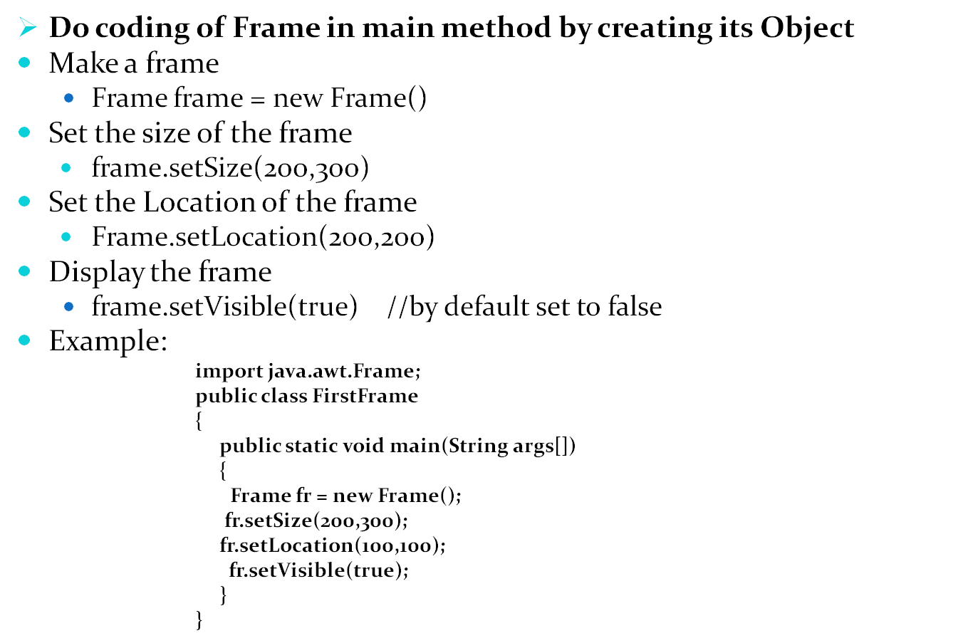
Programme to make Container (Frame) throughAssociation

Slide 6
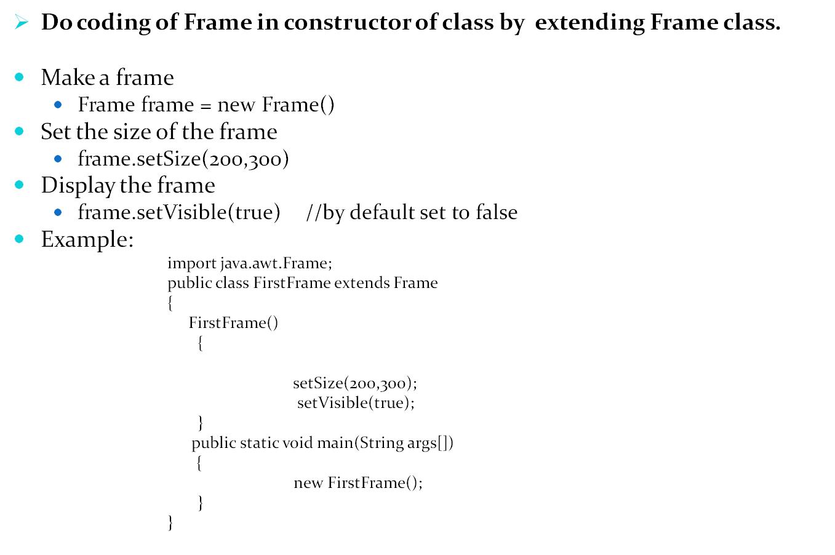
Programme to make Container (Frame) through Inheritence

Slide 7


Window
The Window class defines a top-level Window with no Borders or Menu bar.
  Usually used for application splash screens

Slide 8
Window
import java.awt.*;
class X
{
public static void main(String args[])
{
Window w=new Window(new Frame());
w.setBounds(50,50,500,500);
w.setVisible(true);
w.setLayout(null);
w.setBackground(Color.ORANGE);
Button b=new Button();
b.setBackground(Color.PINK);
w.add(b);
}
}

Slide 9
Panels
When writing a GUI application, the GUI portion can become quite complex.
To manage the complexity, GUIs are broken down into groups of components. Each group generally provides a unit of functionality.
A Panel is a rectangular Container whose sole purpose is to hold and manage components within a GUI.
Panel aPanel = new Panel();
aPanel.add(new Button("Ok"));
aPanel.add(new Button("Cancel"));
Frame aFrame = new Frame("Button Test");
aFrame.setSize(100,100);
aFrame.setLocation(10,10);
aFrame.add(aPanel);
Notes:
The Panel class is probably the most important class within the AWT. Panels can contain Components (which includes other Panels). It allows the GUI screen to be partitioned into manageable pieces. Panels should contain Components which are functionally related. For example, if an application wished to allow the user to input their name, address, phone number and other relevant contact information, it would be good design to place all of the necessary GUI Components on a Panel. That panel can be then added to and removed from other Containers within the application.

Slide 10
Dialog
Dialog control represents a top-level window with a title and a border used to take some form of input from the user.

Slide 11
import java.awt.*;
class X
{
public static void main(String args[])
{
Dialog d=new Dialog(new Frame());
d.setBounds(50,50,500,500);
d.setVisible(true);
d.setLayout(null);
Button b =new Button("fhgfh");
b.setBounds(50,50,100,100);
d.add(b);
}
}

